Slide 1
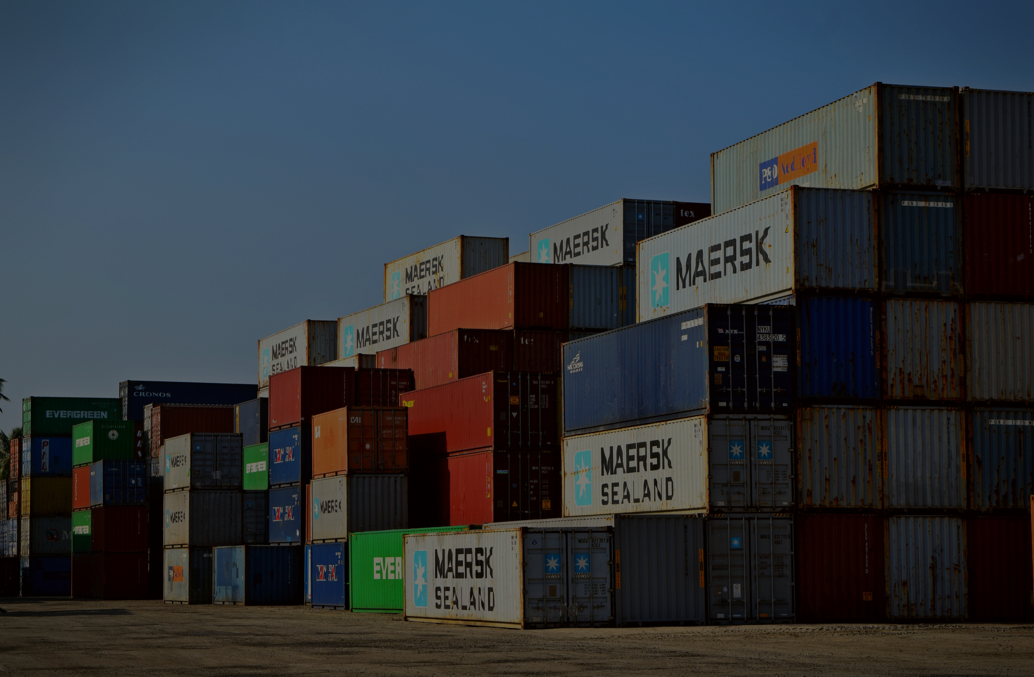


INTERMODAL TRANSPORTATION
CRISIS SIMULATION
Presented by CantCodeDenSleep

Slide 2
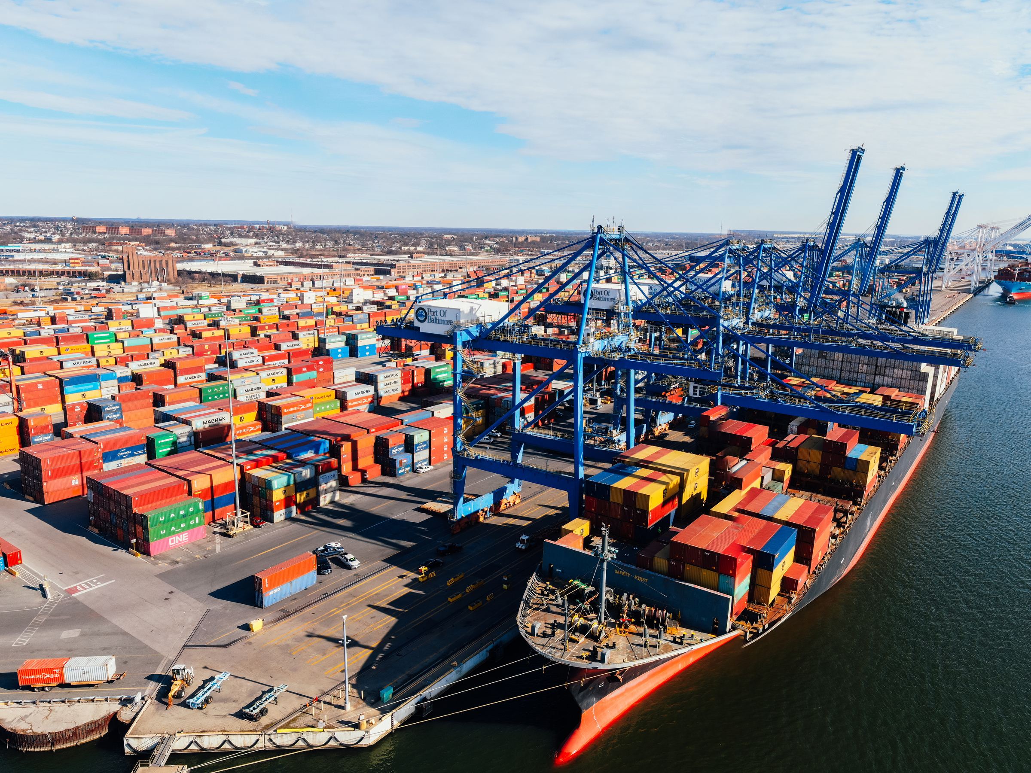
ABOUT OUR PROJECT
Introduction
In today’s fast-paced yet turbulent global supply chains, unpredictable disruptions—whether due to political reasons, extreme weather, epidemic or many unforeseen events—can cause major delays and losses to the transportation industry. Thus, our solution steps in at critical moments to automatically recommend the most cost and time efficient and sustainable rerouting strategies, ensuring the smooth continuation of operations.
Our project leverages cutting-edge AI tools to provide an intelligent, automated solution for identifying the best intermodal transportation methods for regional Crisis. By considering key factors such as cost, transportation time, and stability impact, our AI-powered platform ensures that businesses like PSA can make optimal logistical decisions in real-time, minimising delays and operational costs while adhering to sustainability goals.

Slide 3




Implementation
AI-driven solution
Find optimal alternative
To tackle potential crisies or disruptions, our simulation provides four possible solutions for users to choose from, including an optimal strategy.
Our simulation evaluates the cost ,time and environmental impacts to recommend the most efficient and sustainable routes in quick response to crisis.
Multivariable simulation
Response Evaluation
We are able to run for multivariable simulations in response to the world with more complex supply chain insecurity.
We utilise AI to evaluate the best strategy and offer insights to facilitate business decision making process.

Slide 4



OUR INNOVATION
Port
Resilience
Regional
Resilience
AI decision making
We leverage AI to streamline the decision-making process, providing immediate insights by analyzing both historical data and potential future crises.
Our real-time data analysis and crisis simulation models enable us to estimate port resilience, which can be used to predict potential crisis and propose precautionary measures.
Our understanding of port resilience provides a foundation for estimating regional resilience, which is essential for proactive risk management and comprehensive planning

Slide 5

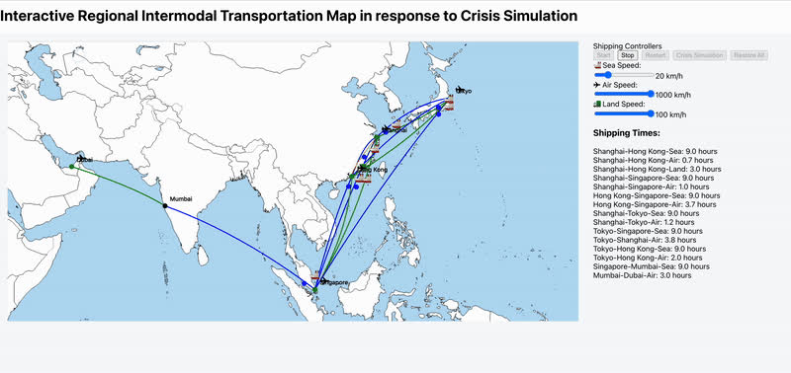
DEMO 1:
Intermodal Transportation Routes Simulation (gif)

Slide 6
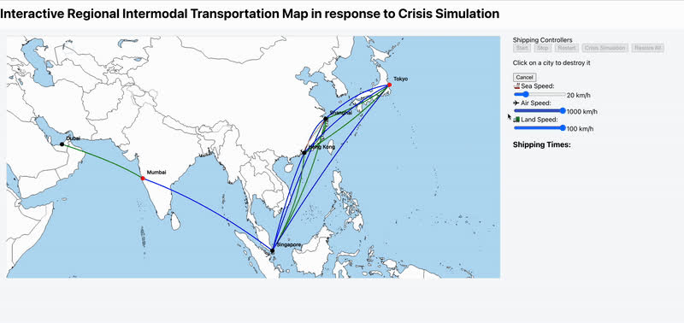
DEMO 2:
Crisis Simulation(gif)

Slide 7
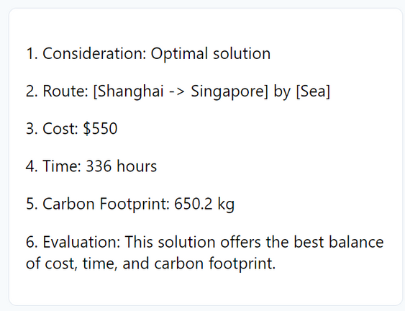
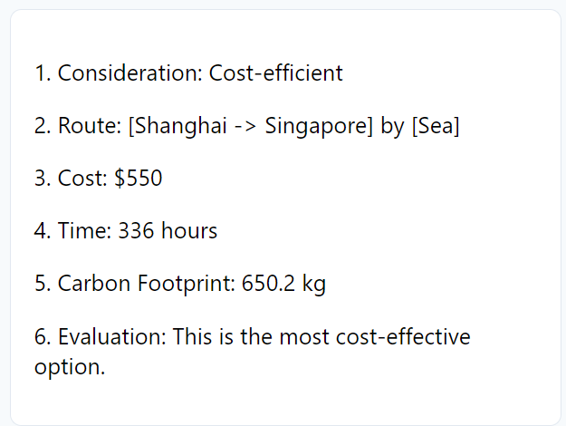
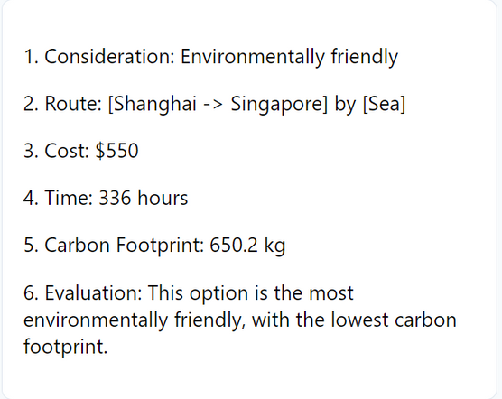
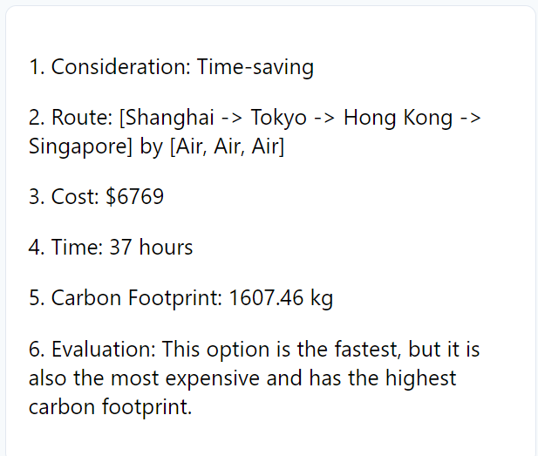
SOLUTION PROVIDE:
Simulation of the Air transport between Shanghai and Singapore is destroyed.
Optimal Solution
Cost-effective
Enrionmental-
friendly
Time-Saving

Slide 8
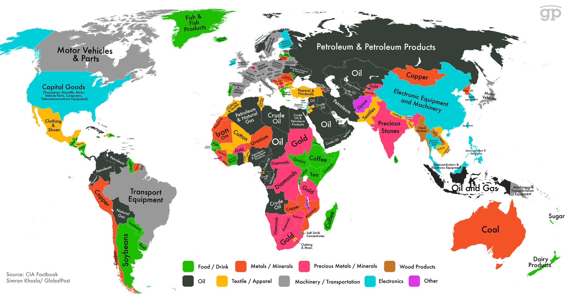


OUR VISION
With the expansion of our regional simulation to a global scope, we hope to have access to more data and can identify additional factors that affect regional and global supply chain stability. We aim to identify cities, routes, and regions that are more prone and vulnerable to crises, evaluate regional stability index and propose precautionary measures, and predict dynamic changes such as weather and demand shifts, along with their impacts on the transportation industry.

Slide 9




SUMMARY & OUTLOOK
Real-Time Shipment Tracking
Our project employs simulation to gather critical insights, optimizing the decision-making process of AI-driven tools for global operations. With future integration of more APIs, we will capture real-time data, such as port inventory and berth availability, enhancing our ability to respond swiftly to disruptions. By leveraging this real-time information, our solution will ensure efficient, resilient, and reliable performance across global supply chains. We hope this will help PSA to provide better and more specialised customer services.
Automated Route Optimization
Our system utilizes Dijkstra's algorithm to determine the most efficient global shipment routes. By calculating the shortest and most cost-effective path from a given source node to every other node in the network, Dijkstra’s algorithm ensures that shipments are routed optimally. This approach enhances the reliability of supply chains by minimizing transit time and cost, while maintaining resilience in the face of disruptions. As a result, it enables a more efficient and globally scalable solution for automated route management.
Various options that cater to different needs
The selected route can be optimized to minimize costs, reduce transit time, or prioritise environmental sustainability, depending on the specific goals of the operation." This revision emphasizes flexibility in route selection based on key priorities: cost-efficiency, speed, or eco-friendliness.

Slide 10
REFERENCE
SEARATES. ‘INTERNATIONAL CONTAINER SHIPPING | ONLINE FREIGHT MARKETPLACE’. ACCESSED 13 OCTOBER 2024. HTTPS://WWW.SEARATES.COM/.
LI, YAN, XUE QIN, AND DAOHENG ZHU. ‘NEARSHORE SIGNIFICANT WAVE HEIGHT PREDICTION BASED ON MIC-LSTM MODEL’. EARTH SCIENCE INFORMATICS 16, NO. 4 (1 DECEMBER 2023): 3963–79. HTTPS://DOI.ORG/10.1007/S12145-023-01134-0.
‘UN COMTRADE’. ACCESSED 13 OCTOBER 2024. HTTPS://COMTRADEPLUS.UN.ORG/.
‘UNITED NATIONS DESINVENTAR OPEN SOURCE INITIATIVE - OFFICIAL WEBSITE’. ACCESSED 13 OCTOBER 2024. HTTPS://WWW.DESINVENTAR.NET/.

Slide 11

THANK YOU

